Slide 1
Classification and severe forms of ROP
Webinar 2

Slide 2
Objectives
In this webinar we will learn:
How to classify ROP?
To learn about severe forms of ROP
Consequences

Slide 3
Classification of ROP
International Classification of ROP (ICROP) is used for classifying ROP
ROP is categorised based on
-The severity into stages (1-5)
-Location into 3 zones (Zone 1-3)
- The presence of plus disease.

Slide 4
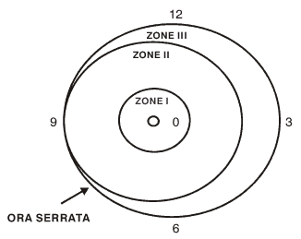
Location
Zone1: a circle whose radius is twice the distance from the centre of the optic disc to the centre of macula
Zone 2: a circle whose radius is the distance from the centre of the optic disc to the nasal margin of the retina
Zone 3: The remainder of the retina, from Zone II to ora-serrata on nasal side and equator on temporal side.

Slide 5
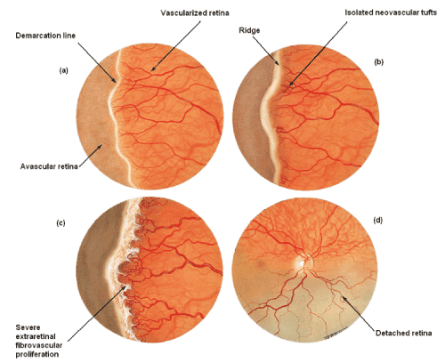
Severity
Stage 1- Thin white line of demarcation s
Stage 2-Addition of depth and width to the demarcation line (Ridge)
Stage 3-Presence of extra retinal fibro vascular proliferation
Stage 4-Partial retinal detachment beginning at the ridge, not involving macula (4A) and involving macula (4B)
Stage 5 Complete retinal detachment

Slide 6
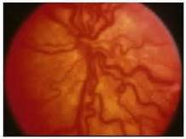
Plus disease
Increased venous dilation
Arteriolar tortuosity of the posterior retinal vessels.
If there is poor pupillary dilatation (rigid pupil), you should suspect plus disease

Slide 7
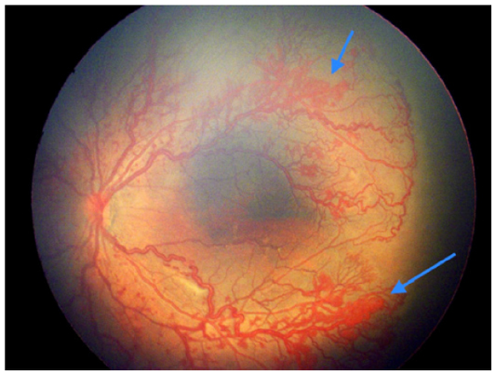
Aggressive posterior ROP (AP-ROP)
Rapidly progressing, severe form of ROP in the smallest and most immature infants
Prominence of plus disease
There is risk of very early retinal detachment
Notes:
Most commonly in Zone I, it may also occur in posterior Zone II

Slide 8
Consequences of ROP
Refractive errors
Squint
Unilateral or bilateral Blindness
Late retinal detachment (6 months-31 years)
Glaucoma

Slide 9
Key messages
ROP is classified based on the severity, location and extent of the disease
The presence of plus disease and APROP needs urgent intervention in the form of laser or surgery
Screening and timely intervention will reduce dire consequences of ROP

Slide 10
Thanks

